Slide 1
Capstone Project
Airbnb Bookings Analysis - EDA
cohort Austin -By PRETESH AGARWAL

Slide 2
Introduction Problem Statement Key objectives we are focusing on Data Preparation & Data Wrangling Data Discription Exploratory Data analysis Key findings Challenges faced Conclusion
Points for Discussion:

Slide 3

Introduction
What is Airbnb?
Airbnb, Inc. is an American company that operates an
online marketplace for lodging, primarily homestays
for vacation rentals, and tourism activities. Based in
San Francisco, California, the platform is accessible
via website and mobile app. Airbnb does not own any
of the listed properties; instead, it profits by receiving
commission from each booking. The company was
founded in 2008 by Brian Chesky, Nathan Blecharczyk
and Joe Gebbia. Airbnb is a shortened version of its
original name, AirBedandBreakfast.com.

Slide 4
Problem Statement
Data analysis on millions of listings provided through Airbnb is a
crucial factor for the company. These millions of listings generate
a lot of data - data that can be analyzed and used for security,
business decisions, understanding of customers' and providers'
(hosts) behavior and performance on the platform, guiding
marketing initiatives, implementation of innovative additional
services and much more.
This dataset has around 49,000 observations in it with 16
columns and it is a mix between categorical and numeric values.

Slide 5
Key objectives
1. What can we learn about different hosts and areas?
2. What can we learn from predictions? (ex: locations, prices, reviews, etc)
3. Which hosts are the busiest and why?
4. Is there any noticeable difference of traffic among different areas and what
could be the reason for it?

Slide 6
Data Preparation & Data Wrangling
● Dropping unnecessary data:
as "last_review" and "reviews_per_month" have more than 10,000 null values, it affects the outcomes of Data analysis; So, we are removing these columns and also as we are not doing any analysis specifically on latitude and longitude, we're also removing these variables as well.
● Verifying Data quality:
We have gone through whole data and checked null values and reviewed any missing
data or wrong data. And prepared whole data ready for exploratory data analysis.
● Basic data exploration:
Using describe() and info () and size functions of pandas. Gone through a basic
exploration of data before entering into EDA.

Slide 7
Data Description
● id: unique reference number for each different hotel.
● name: name of different hotels of various neighborhood groups.
● host_id: unique reference id of each individual host.
● host_name: name of host hosting different hotels.
● neighbourhood_group: aggregate group of neighborhood cities of some
particular regions.
● neighbourhood: cities present in NYC.
● latitude: latitude is a geographic coordinate that specifies the north–south
position of a point on the Earth's surface. Latitude is an angle which ranges
from 0° at the Equator to 90° at the poles.
● longitude: Longitude is a geographic coordinate that specifies the east–west
position of a point on the Earth's surface, or the surface of a celestial body.

Slide 8
Data Description continued…
● room_type: Different room types available for booking, which contains Private
room, Entire home/apt, Shared room.
● price: price per each night stay of different room types at various hotels.
● minimum_nights: minimum nights booked in particular hotel.
● number_of_reviews: count of reviews got for each hotel.
● last_review: date of last review got by a customer to a particular hotel.
● reviews_per_month: count of reviews getting per month of a particular hotel.
● calculated_host_listings_count: It represents total number of listings made
by a specific host. In some cases, the properties are same but some of the
other features differ like(room_type).
● availability_365: number of available days for booking in a year

Slide 9

Exploratory Data Analysis
Tools used for EDA:
● Programming Language: Python
● Libraries: Pandas
Matplotlib
● Microsoft Excel

Slide 10
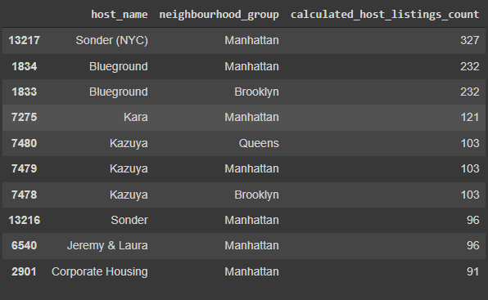
1) Top Hosts and their listings count:
For analyzing this we used group by function and took 'host_name', 'neighbourhood_group', and "calculated_host_listings_count" and calculated the
top 10 hosts.

Slide 11
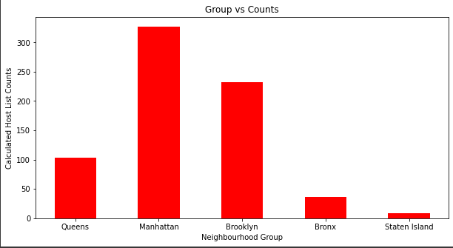
Key findings:
Manhattan neighbourhood group hosts are out-performing in listings.
7 out of top 10 hosts are from the ''Manhattan'' neighbourhood group.
2 out of top 10 hosts are from the ''Brooklyn" neighbourhood group.
1 out of top 10 hosts are from the ''Queens" neighbourhood group.

Slide 12
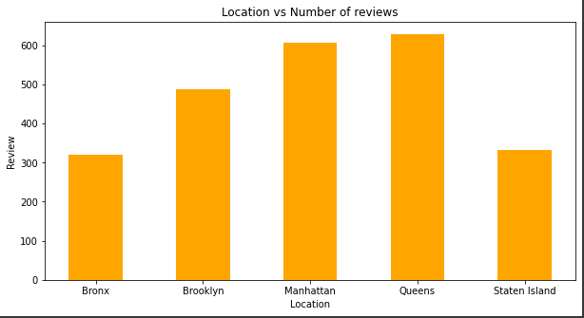
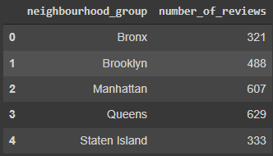
2) What can we learn from predictions? (ex: locations, prices, reviews, etc)
For this question, we approached with 3 different corelations:
1. “neighbourhood_group” and “number_of_reviews”.
After this analysis we can say that people who lived in Queens, Manhattan and
Brooklyn have given most number of reviews.

Slide 13
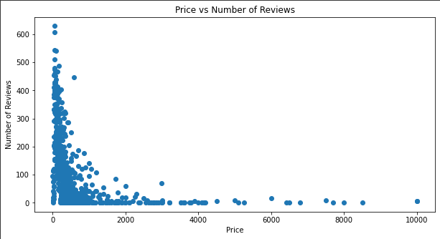
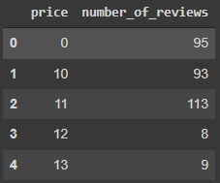
2. “Price” and “number_of_reviews”.
After this analysis we can say that most people prefer to stay in place where
price is less.

Slide 14
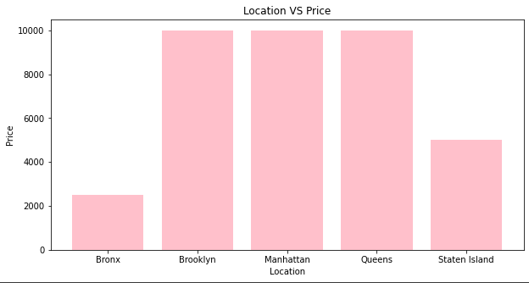
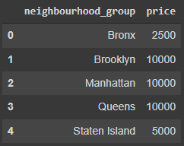
3. “neighbourhood_group” and “Price”.
After this analysis we can say that maximum prices for Brooklyn, Manhattan
and Queens are same 10000.

Slide 15
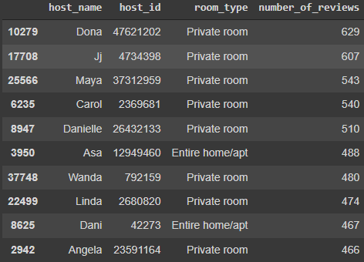
3) Finding Busiest Host
Next, we were interested in finding the busiest hosts by considering “number_of_reviews”. We took, “host_name”, “host_id”, “room_type”, “number_of_reviews”, and got the following result.

Slide 16
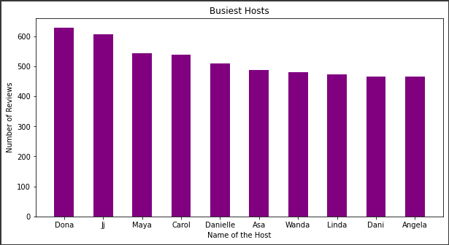
Key findings:
Top 5 busiest hosts are:
Dona
Ji
Maya
Carol
Danielle
Because these hosts listed room
type as Entire home and Private
room which is preferred by most
number of people.

Slide 17
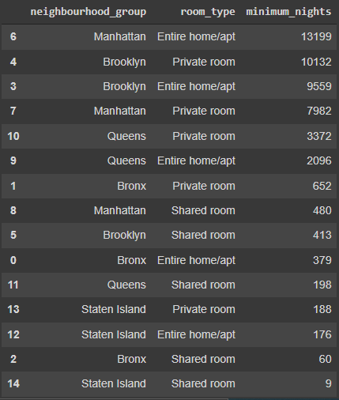
4) Is there any noticeable difference of traffic among different areas and what could be the reason for it?
Our main motive through this step was
to find traffic among different types of
rooms at different neighborhood
groups.
For this we took,
'neighbourhood_group',
'room_type', 'minimum_nights' to
analyze this question.

Slide 18
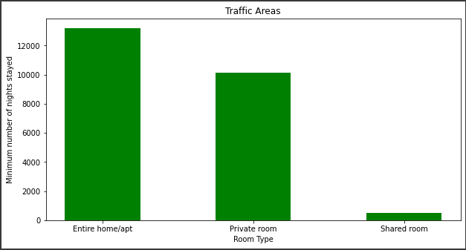
Key findings:
In Manhattan, people are preferring "Entire Home/apt".
But, in Brooklyn, Queens and Bronx people are preferring private rooms.
In Staten Island, people are having equal preference over all three types of rooms.

Slide 19
Challenges faced
Verifying quality of such huge data and looking for error values.
Dropping down irrelevant data and making the whole data getting ready for full pledged data analysis.
Understanding and visualizing complex numerical data, and communicating
business solutions.
Analysing and solving various queries and presenting clear cut outputs.

Slide 20
Conclusion
Airbnb dataset-2019 appeared to be a very rich dataset with a variety of columns that allowed us to do deep data exploration on each significant column presented.
First, we have found hosts that take good advantage of the Airbnb platform and provide the most listings; we found that our top host has 327 listings. After that, we proceeded with analysing boroughs and neighbourhood listing densities and what areas were more popular than another.
From the entire analysis on Airbnb bookings analysis, our assumptions before analysis went totally different after getting results from the analysis. The whole EDA process gave very fascinating results and insights that will be helpful for business development and expansion, budget allocations and focusing on things people prefer.

